Slide 1
Welcome to Demo Day!
Prof. Dr. Dirk Riehle
Friedrich-Alexander University Erlangen-Nürnberg
AMOS I01
Licensed under CC BY 4.0 International
Notes:
It is Friedrich-Alexander University Erlangen-Nürnberg – FAU, in short.
Corporate identity wants us to say “Friedrich-Alexander University”.

Slide 2
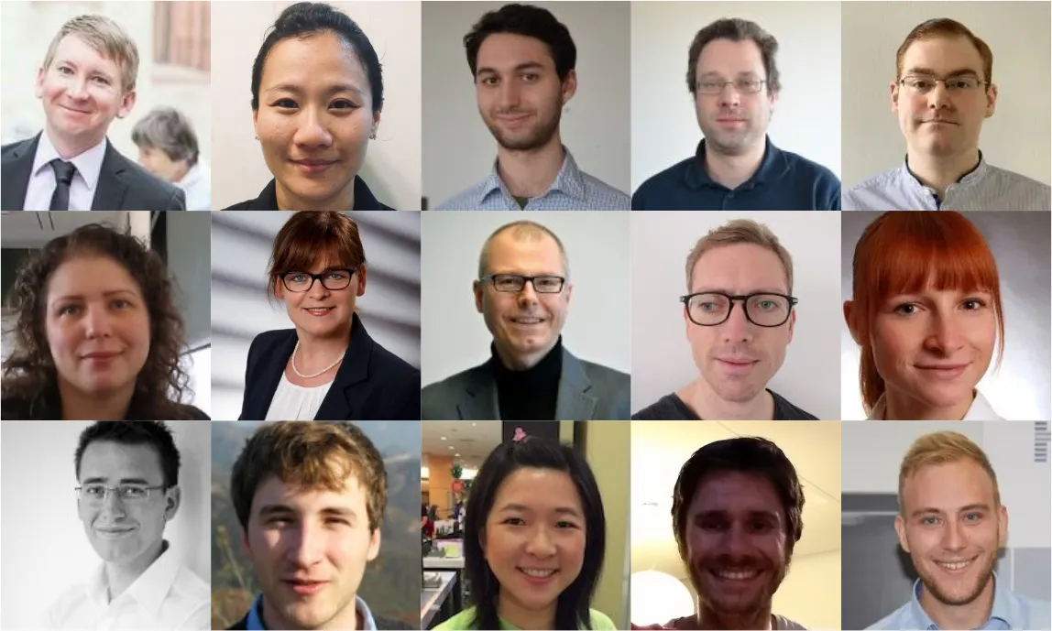
The Professorship for Open Source Software

Slide 3



















Industry Partners and Teaching Projects
...

Slide 4
The 2021 AMOS Projects
EMBA Service (with Siemens Energy)
Context Map for Corporate Data (with CPU 24x7)
Synthetic File System (with GRAU DATA)
Inner Source Project Linter (with DATEV)
3D Viewer (with Büren & Partner)
Neural Network Enablement (with Huawei)
Notes:
These are the available projects; at start of course, students will already have been assigned to teams and projects.

Slide 5
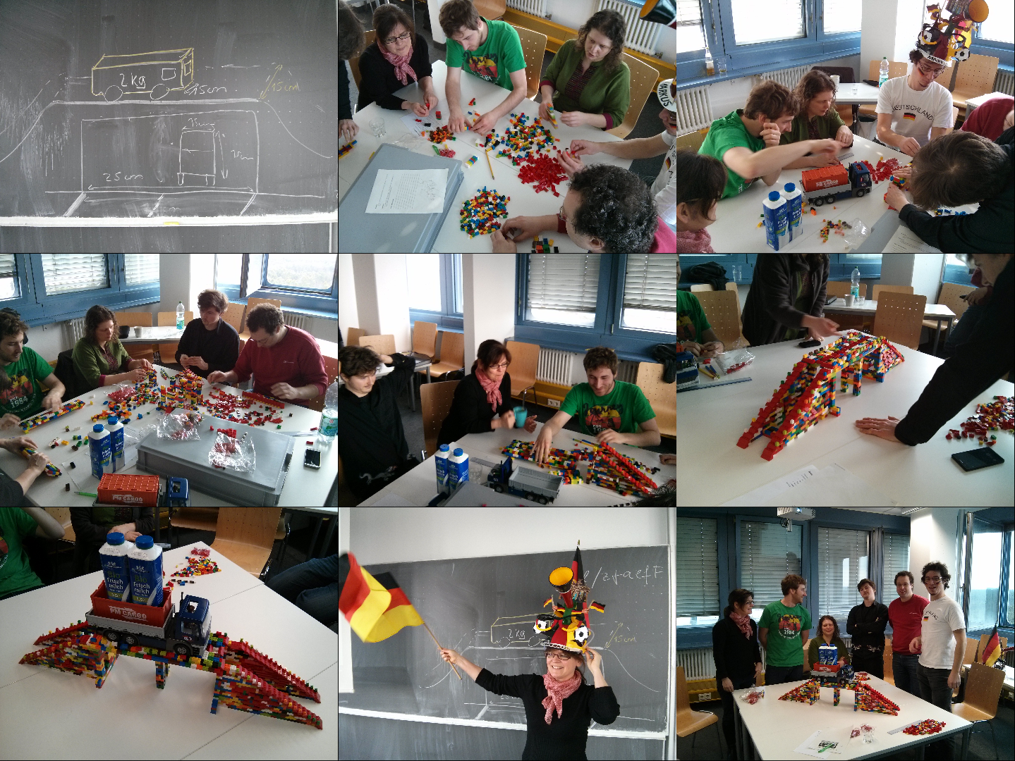

Slide 6
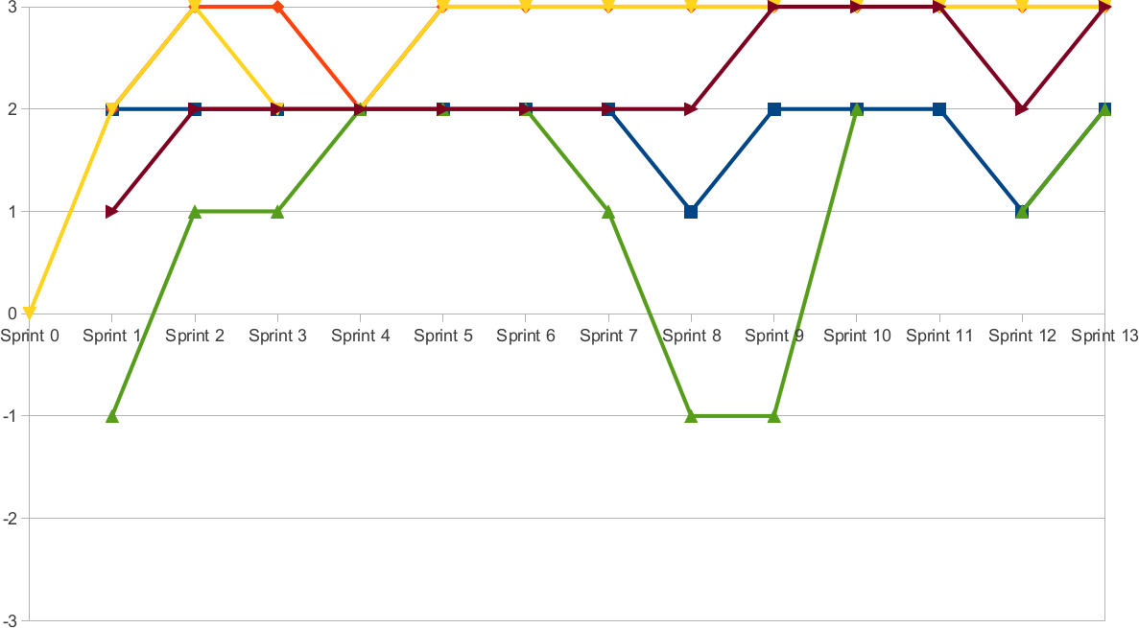
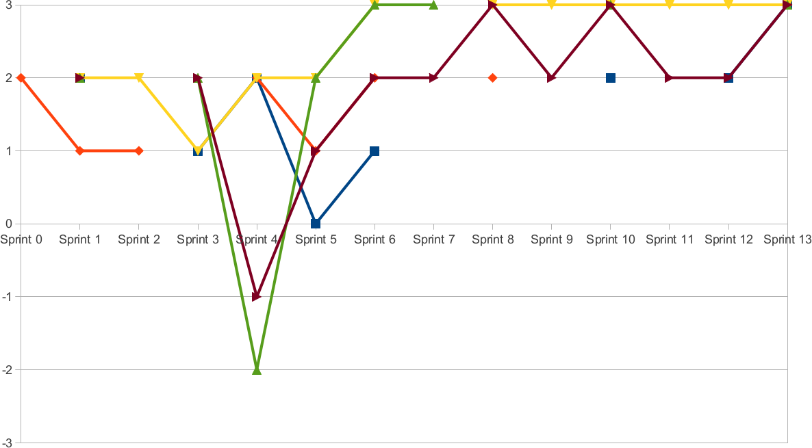
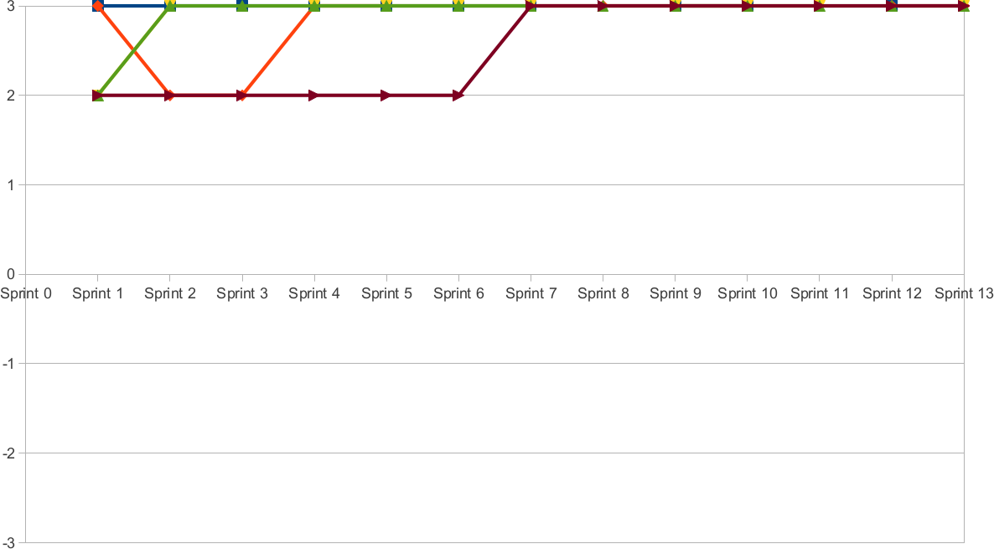

Slide 7
Project 1 slide

Slide 8
Project 2 slide

Slide 9
Project 3 slide

Slide 10
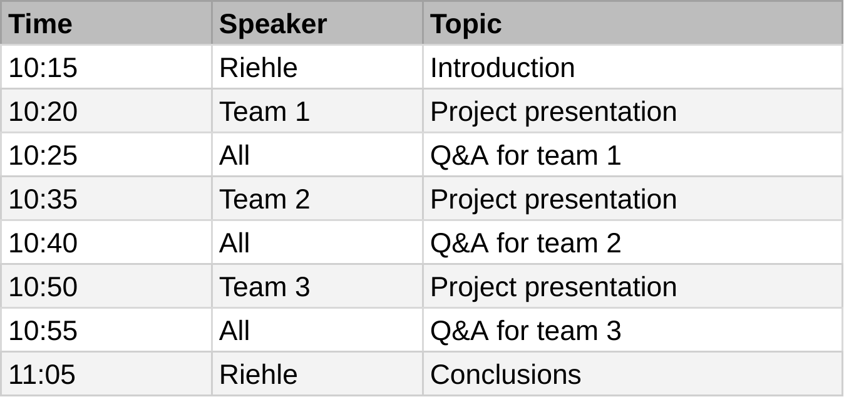
2020 AMOS Demo Day Agenda and Rooms

Slide 11
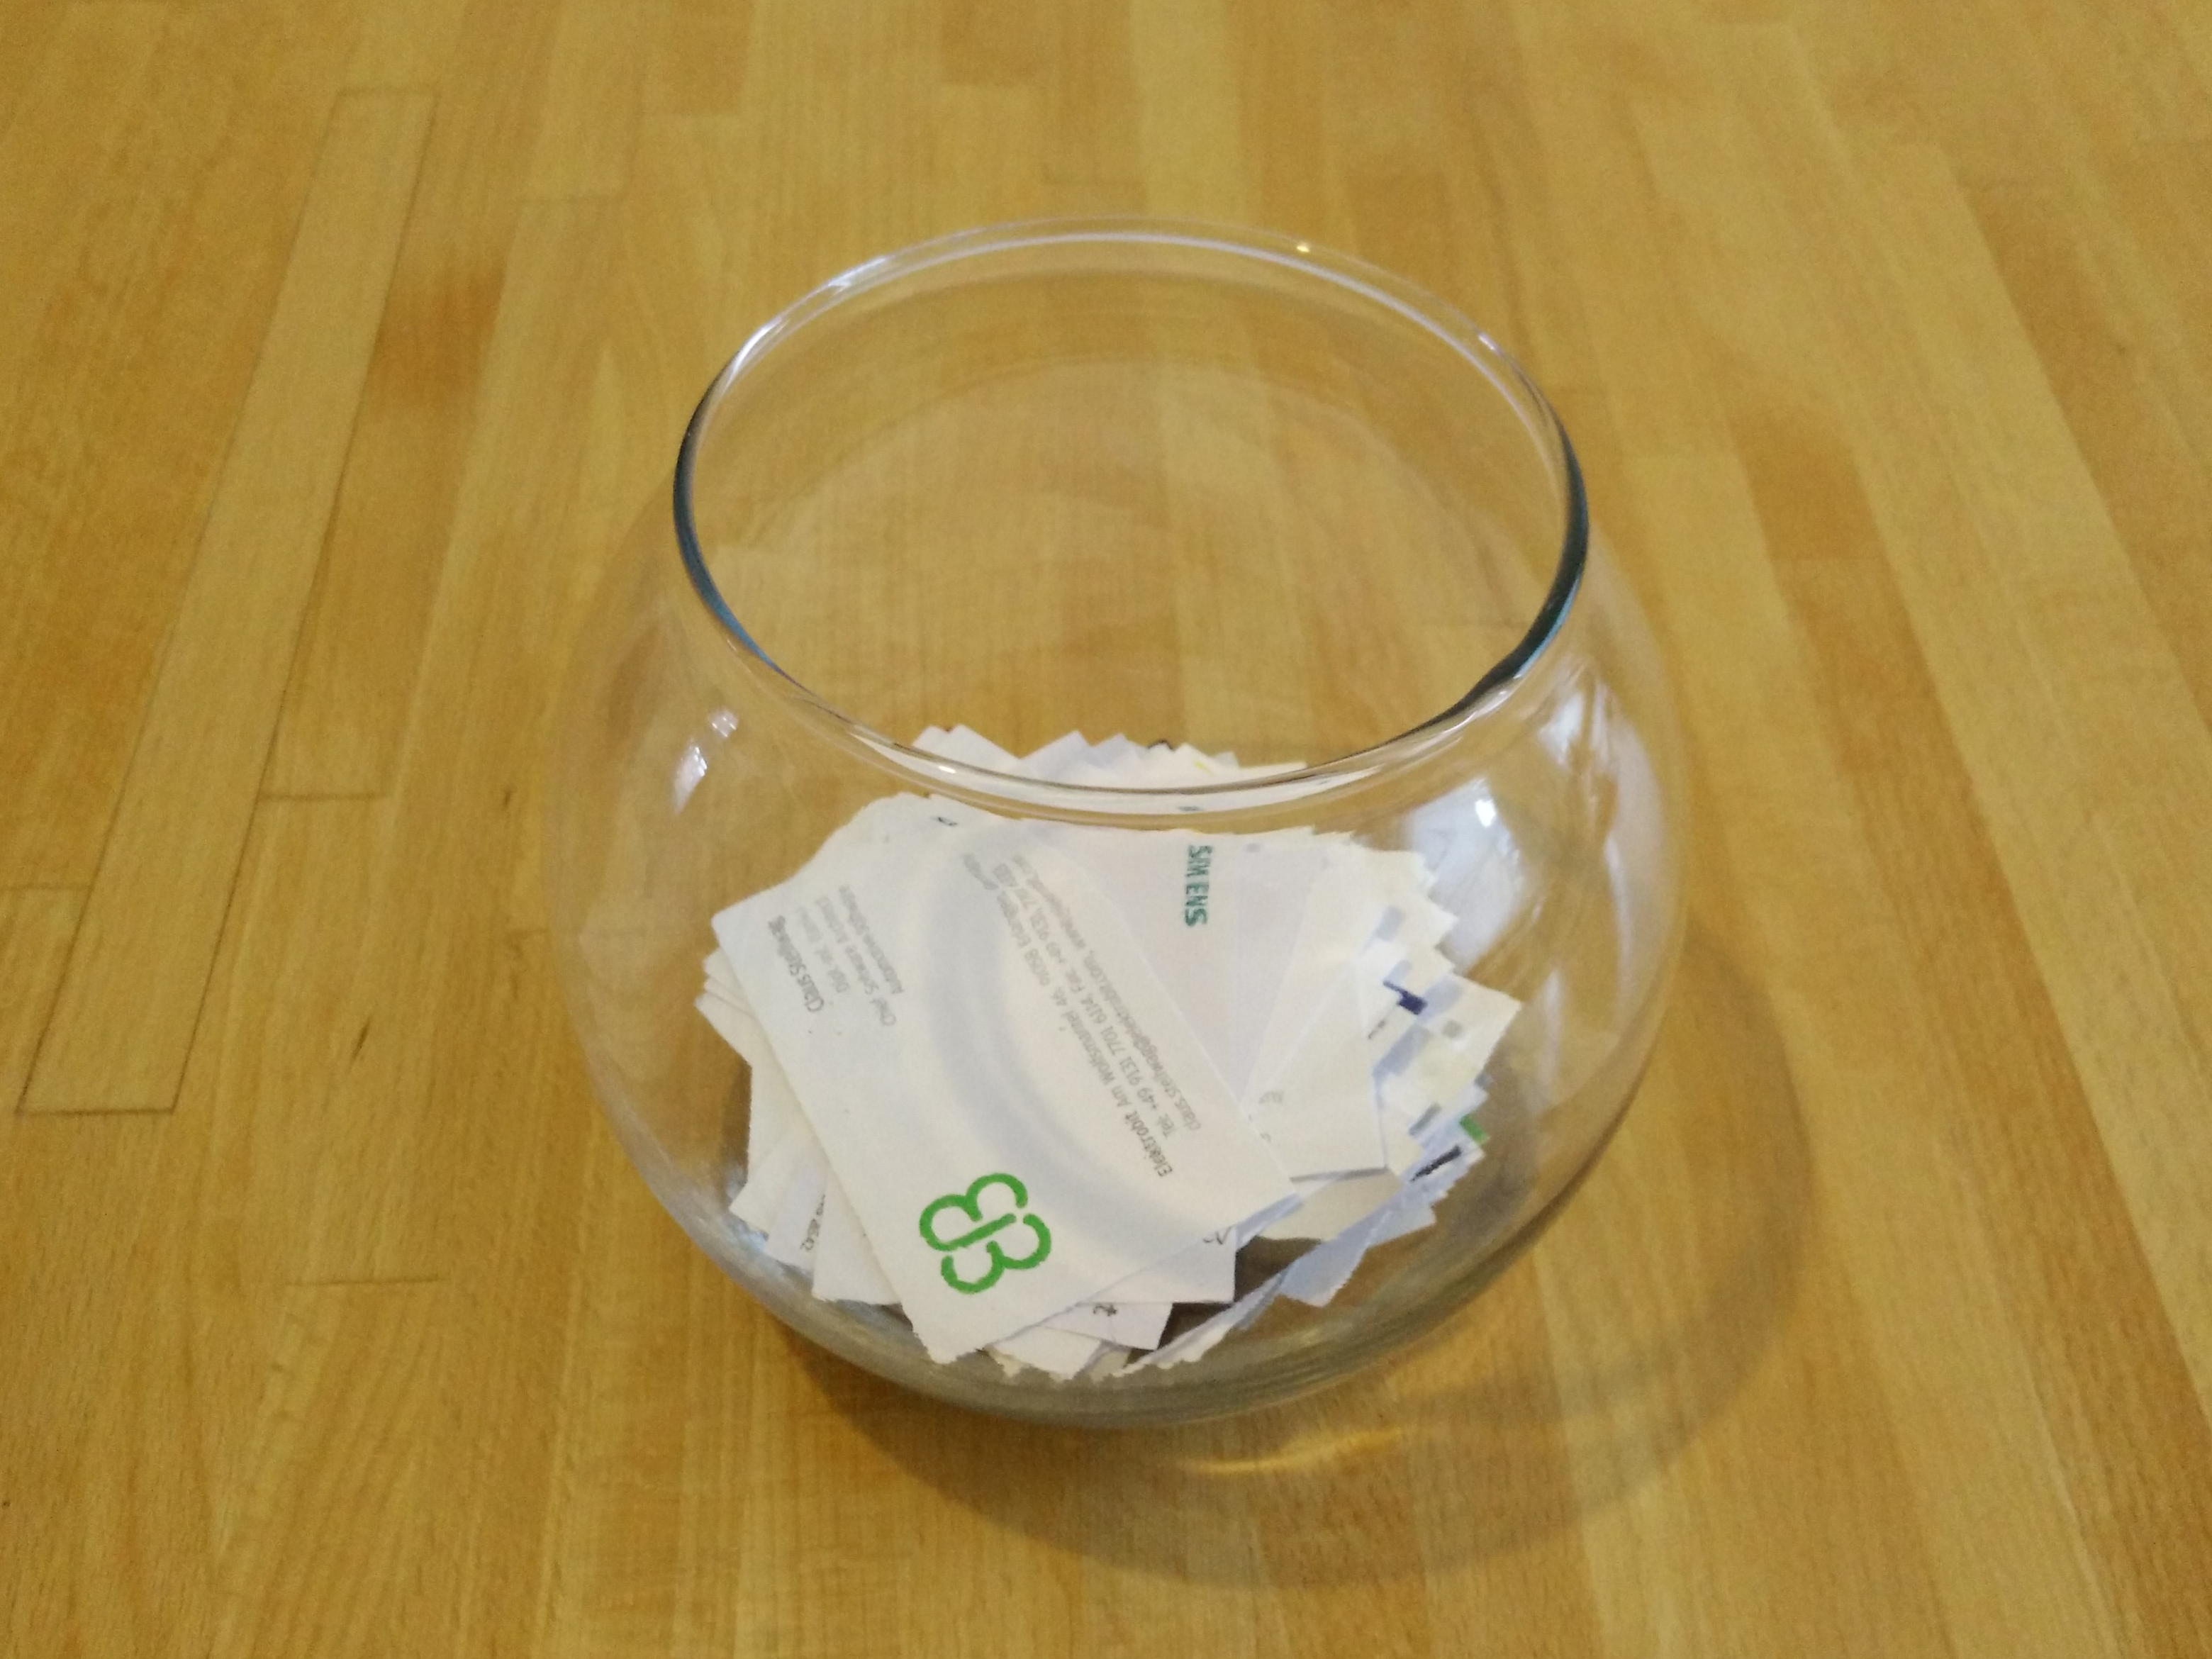

Slide 12
Thank you! Questions?
dirk.riehle@fau.de – https://oss.cs.fau.de dirk@riehle.org – https://dirkriehle.com – @dirkriehle
DR

Slide 13
Credits and License
Original version
  © 2021 Dirk Riehle, some rights reserved
  Licensed under Creative Commons Attribution 4.0 International License
Contributions
  None yet

